Slide 1
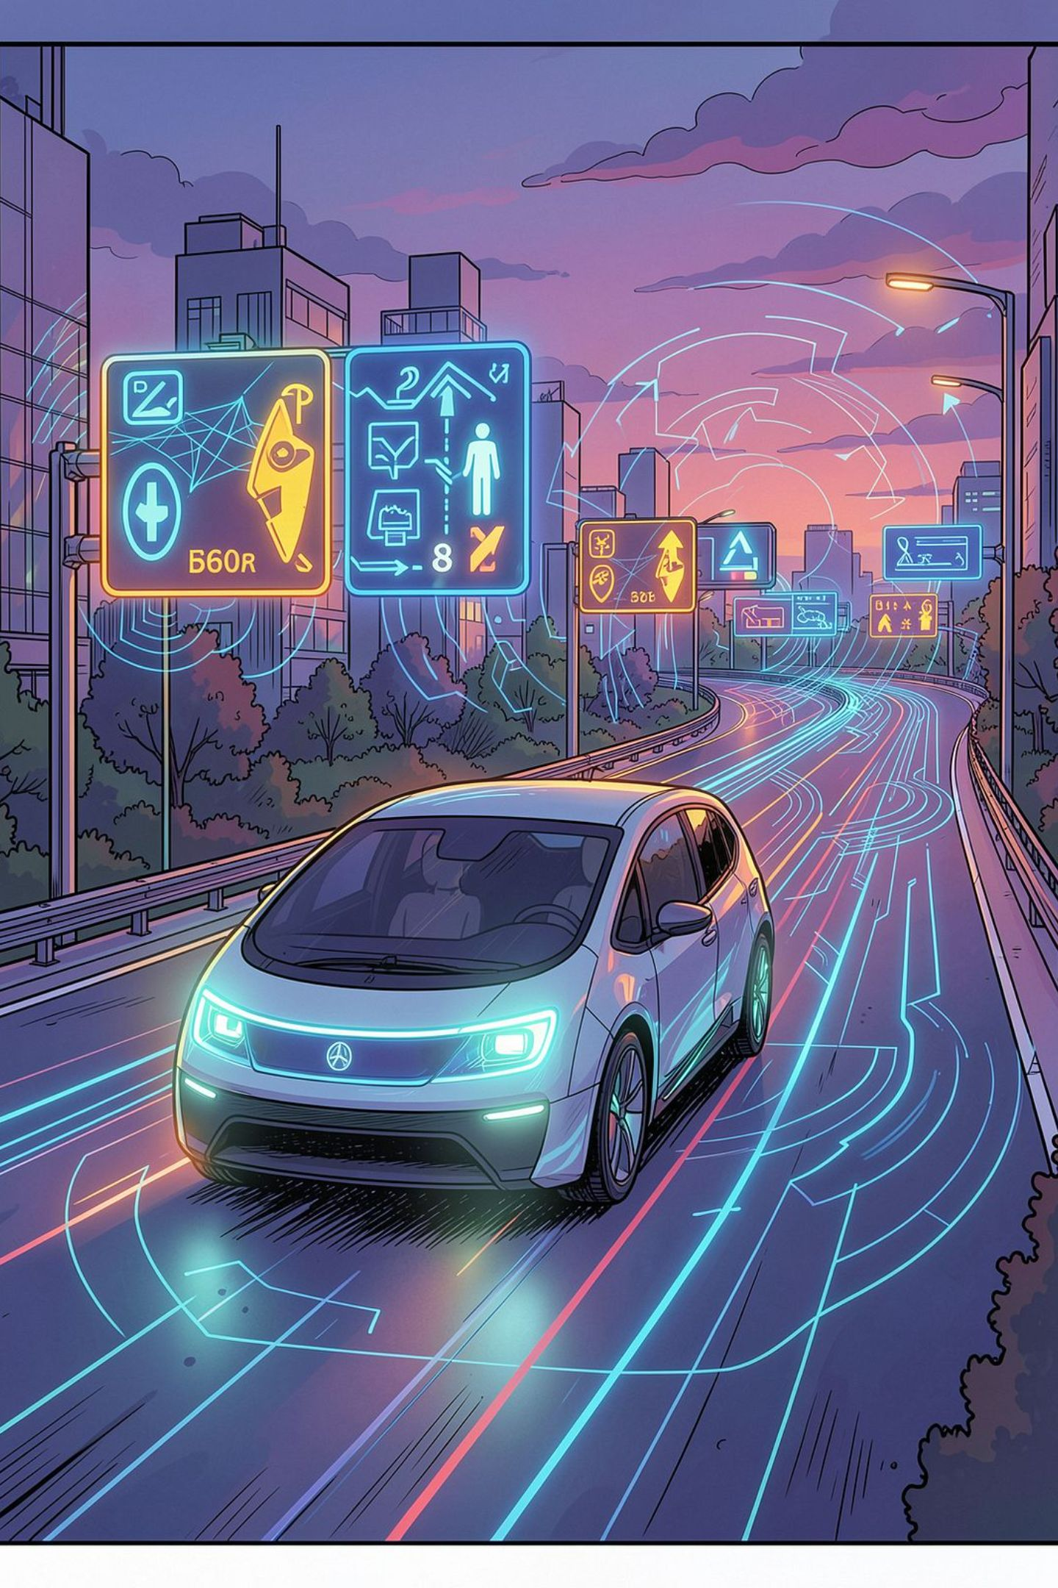
Traffic Road Sign Recognition & Classification System
A real-time computer vision and deep learning platform for intelligent transportation systems, ADAS, and autonomous vehicles.
COMPUTER VISION
DEEP LEARNING
AUTONOMOUS MOBILITY

Slide 2

Why Traditional Methods Fall Short
Environmental Variability
Lighting changes, rain, fog, and glare degrade image quality, causing traditional image processing to fail.
Sign Degradation
Faded, occluded, or physically damaged signs are frequently misidentified by rule-based algorithms.
Motion & Speed
High-speed capture introduces motion blur, making real-time detection a critical engineering challenge.
Scale & Diversity
Thousands of sign variants across regions and countries exceed the capacity of hand-crafted feature detectors.

Slide 3

Proposed Solution: An Intelligent Recognition Pipeline
The system automatically detects, localizes, and classifies traffic signs in real time — assigning confidence scores and surfacing results through an interactive analytics dashboard.
CNN Classification
Image Capture
Feature Detection
Dashboard Reporting
Images are captured via vehicle-mounted cameras or infrastructure sensors, preprocessed to remove noise, analyzed through a deep learning model, and classified into Warning, Regulatory, Mandatory, and Informational categories with per-prediction confidence scores.

Slide 4
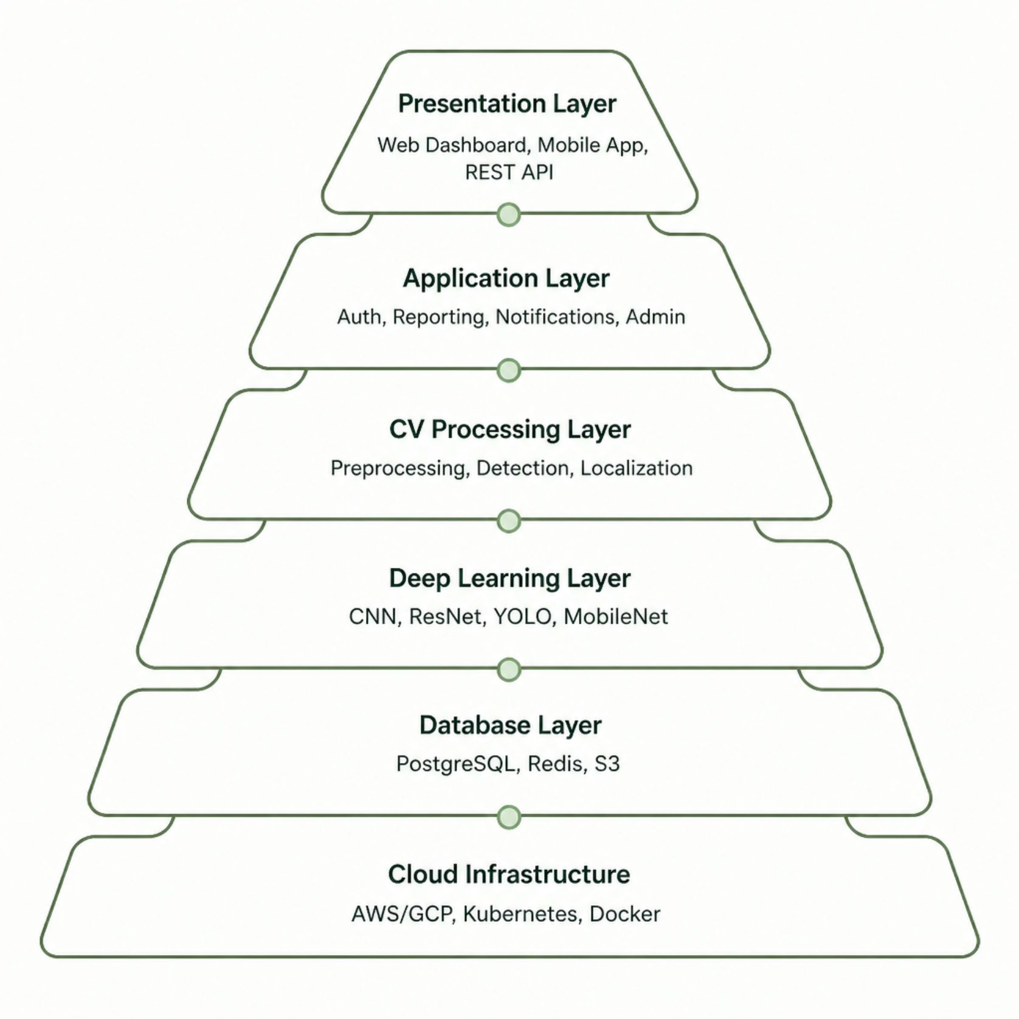
System Architecture
Layered Design for Scalability
Each layer is independently deployable, enabling horizontal scaling and fault isolation across cloud and edge environments.
Presentation: React-based dashboard and mobile interfaces
Application: Business logic, RBAC, and notification engine
CV & DL: OpenCV preprocessing + PyTorch/TensorFlow inference
Data: PostgreSQL for metadata, Redis for caching, S3 for image storage

Slide 5






End-to-End Workflow
Image Acquisition
Preprocessing
Capture frames from vehicle cameras or roadside infrastructure.
Noise removal, contrast enhancement, and normalization.
Detection & Localization
Classification
YOLO/Faster R-CNN localizes sign bounding boxes.
CNN/ResNet assigns sign category and confidence score.
Visualization & Reporting
Continuous Learning
Results rendered on dashboard; reports generated automatically.
New data retrains models for ongoing accuracy improvement.
The pipeline processes frames in under 50 ms, supporting real-time inference at highway speeds with continuous feedback loops for model retraining.

Slide 6
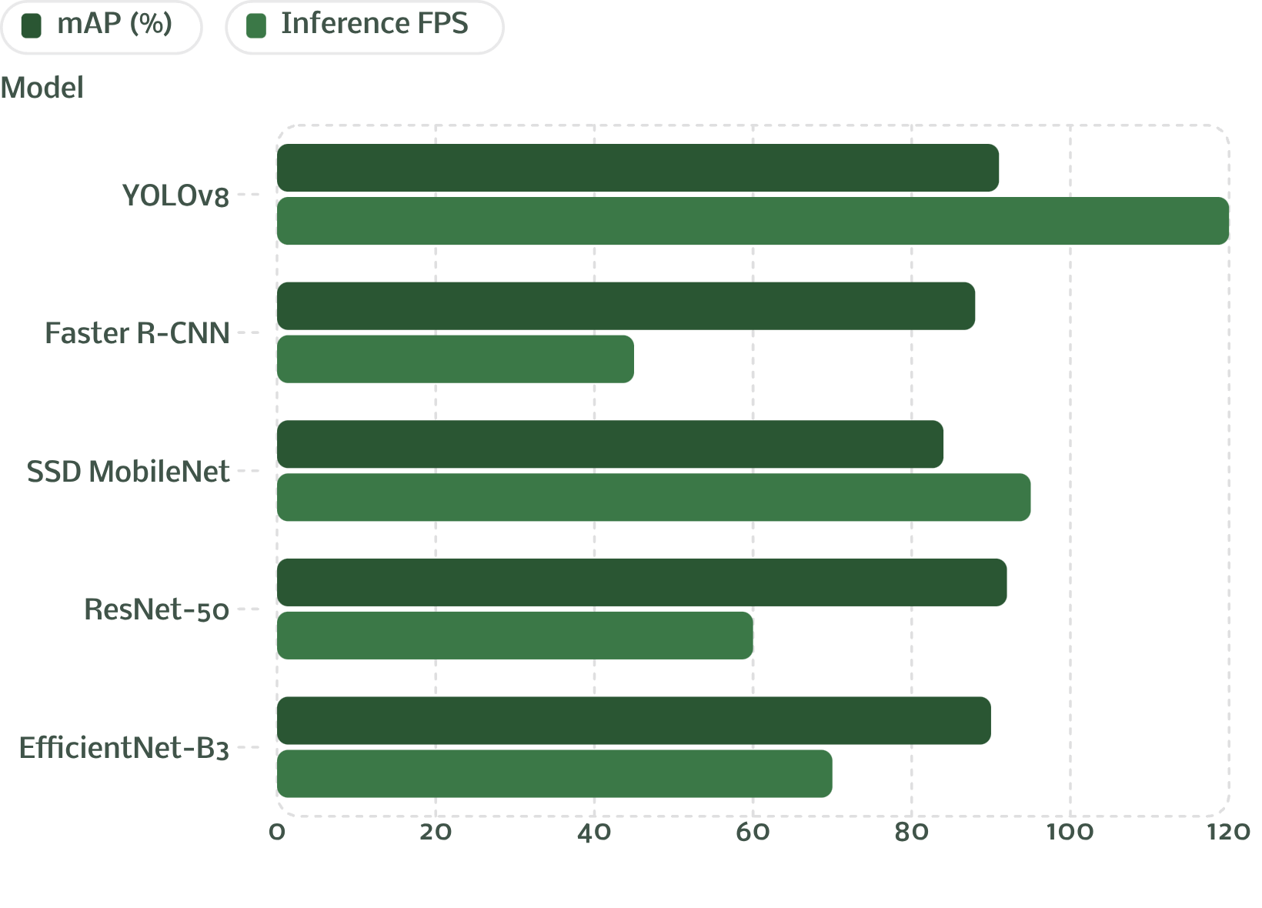
Deep Learning Models & Evaluation
Model Selection Trade-offs
YOLOv8 leads in speed for real-time ADAS; ResNet-50 and EfficientNet excel in classification accuracy. Faster R-CNN suits high-precision offline analysis.
Primary metrics: mAP, F1-Score, Precision, Recall
Latency target: <50 ms per frame on GPU
Augmentation: rotation, brightness, occlusion simulation
Continuous learning pipeline with versioned datasets

Slide 7





Technology Stack
Frontend
Backend
Computer Vision
React.js, Redux, D3.js, and Chart.js for the interactive analytics dashboard and real-time visualization.
Python Flask/FastAPI, Node.js, RESTful APIs with JWT authentication and role-based access control.
OpenCV, scikit-image, and Albumentations for preprocessing, augmentation, and feature extraction.
Deep Learning
Data & Cloud
PyTorch, TensorFlow, Keras — training and deploying CNN, YOLO, ResNet, and EfficientNet models.
PostgreSQL, Redis, AWS S3, Docker, Kubernetes on AWS/GCP for scalable, cloud-native deployment.

Slide 8
Functional & Non-Functional Requirements
Functional Requirements
Non-Functional Requirements
Secure multi-factor authentication with RBAC
Image upload, batch processing, and live camera feed
Real-time traffic sign detection and classification
Confidence scoring with explainability overlays
Analytics dashboard, report generation, and alerts
Dataset management and model versioning
Scalability: Horizontal scaling via Kubernetes auto-scaling
Availability: 99.9% uptime SLA with failover redundancy
Security: TLS encryption, OWASP compliance, audit logging
Performance: <50 ms inference, 500+ concurrent users
Reliability: Automated retraining and drift detection

Slide 9
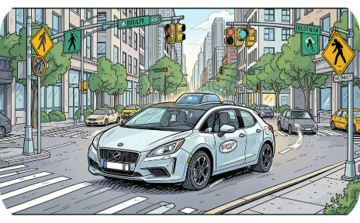
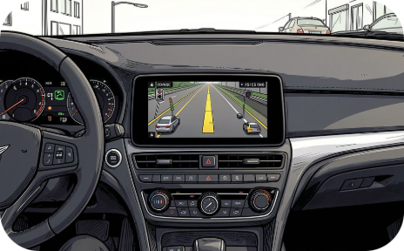
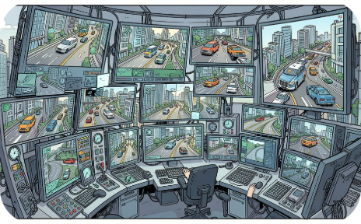
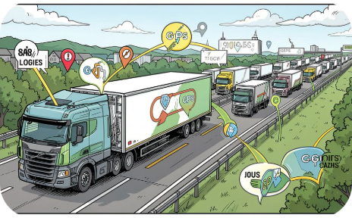
Real-World Applications
Autonomous Vehicles
ADAS Systems
Smart City Infrastructure
Fleet & Logistics
Speed limit alerts, stop sign warnings, and regulatory sign notifications to assist drivers.
Enables route compliance, regulatory adherence, and safety auditing across commercial fleets.
Real-time sign interpretation for safe, rule-compliant navigation without human intervention.
Roadside cameras feed into traffic management centers for city-wide sign compliance monitoring.

Slide 10

Challenges, Future Roadmap & Conclusion
Implementation Challenges
Future Enhancements
Adverse weather, occlusions, and degraded signs
Real-time constraints on edge devices
Dataset diversity across geographies
Maintaining accuracy under domain shift
Transformer-based vision models (ViT, DETR)
LiDAR fusion and multimodal perception
Vehicle-to-Infrastructure (V2I) integration
Explainable AI and multilingual sign recognition
Mobile edge deployment and federated learning
Solutions: Data augmentation, transfer learning, edge AI optimization, and federated learning.
This system unites computer vision and deep learning to detect and classify traffic signs in real time — advancing road safety, intelligent transportation, and the next generation of autonomous mobility.

